Slide 1
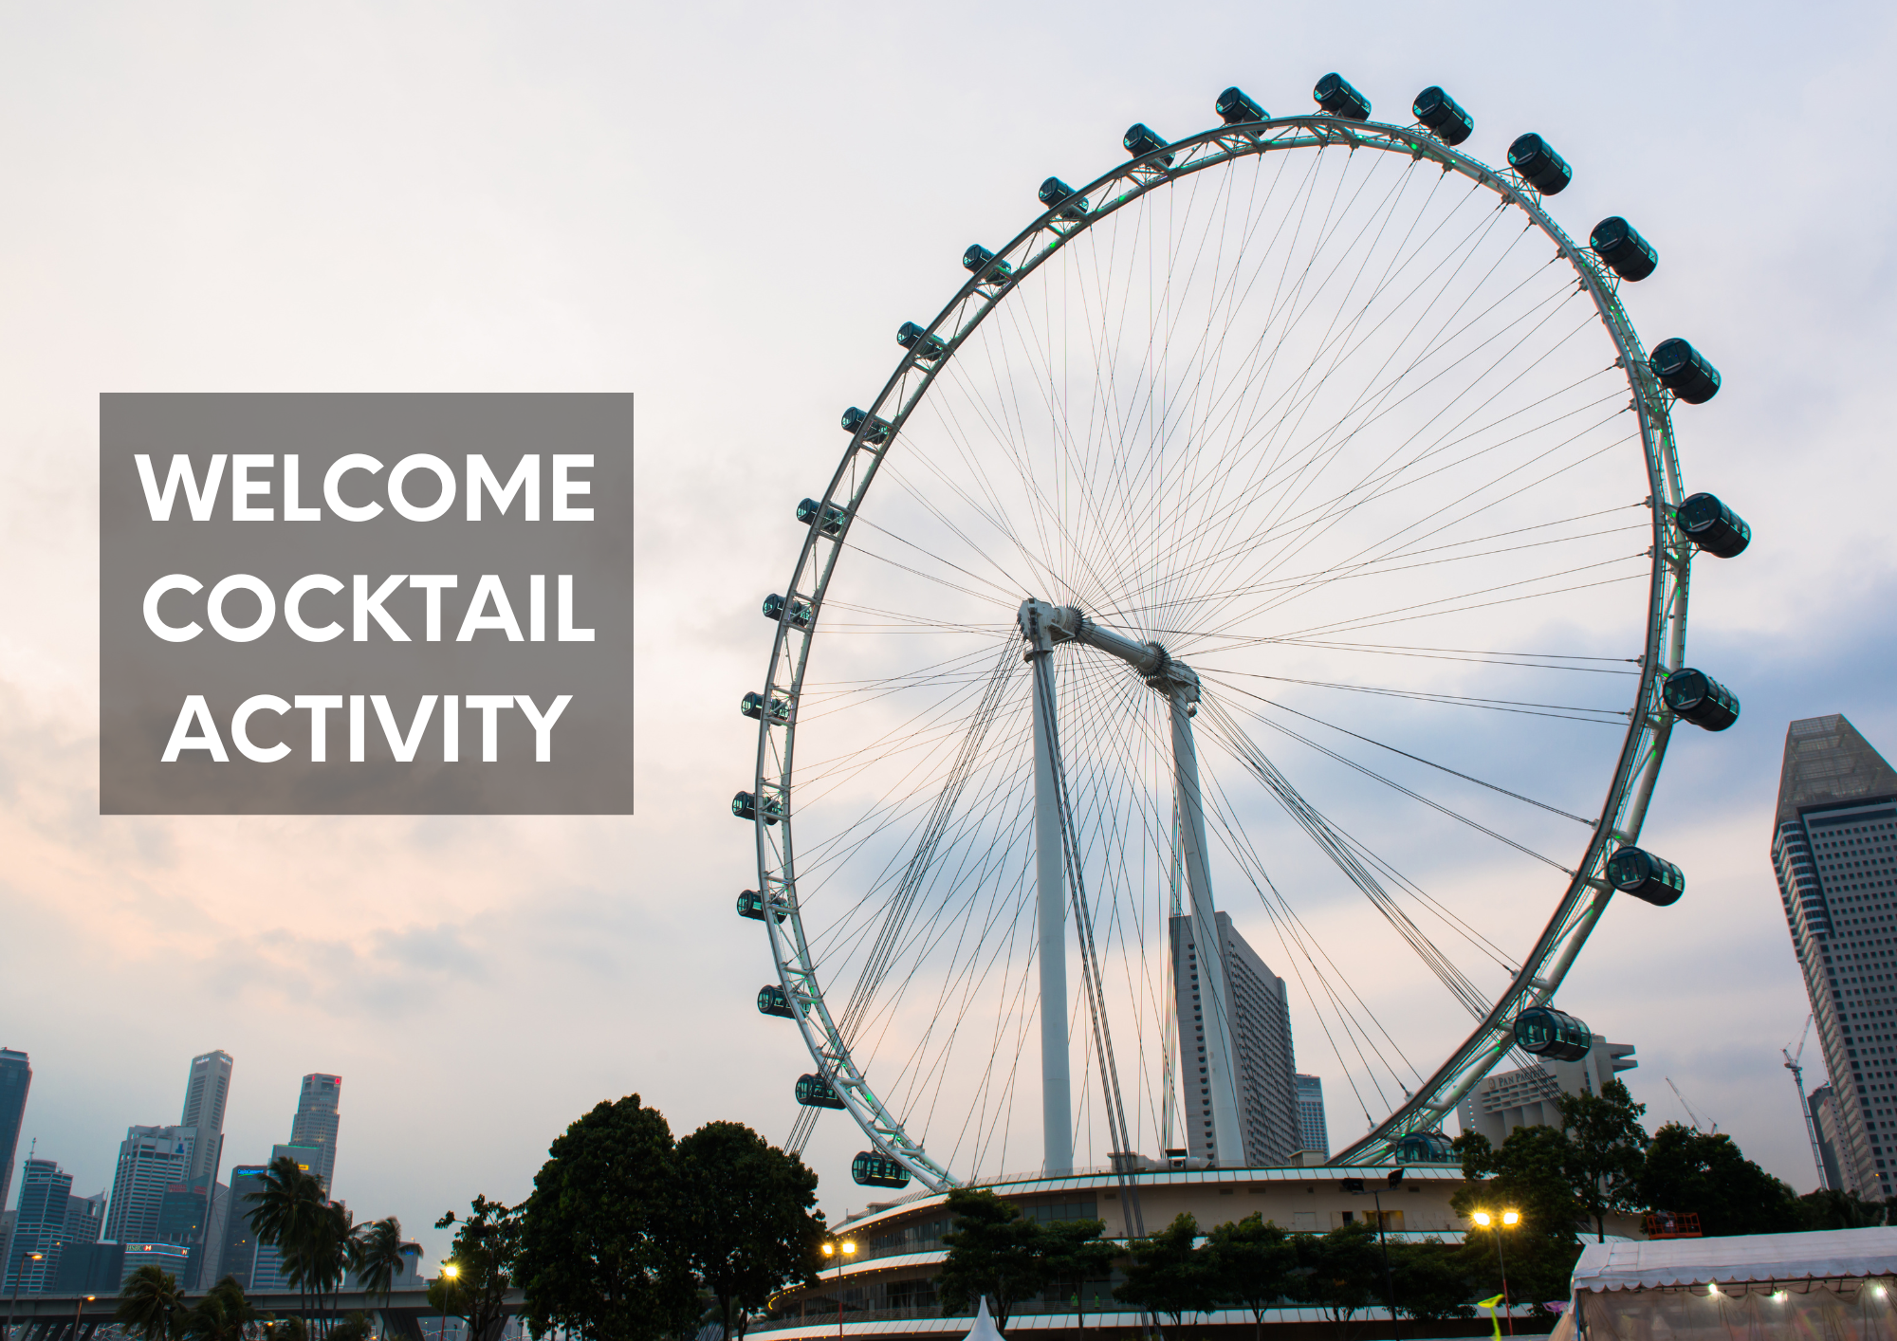
IFFRO World Congress 2025 Welcome Cocktail
The Welcome Cocktail for this year’s IFFRO World Congress will be held at the Singapore Flyer.
Here’s some information that will help make your visit a richer experience!

Slide 2
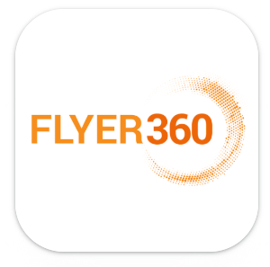
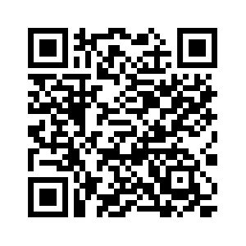
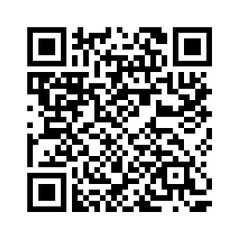
Flyer360
You will be able to take your experience to the next level visiting the Singapore Flyer through AR with the Flyer360, an immersive companion app!
Google Store
Apple Store

Slide 3
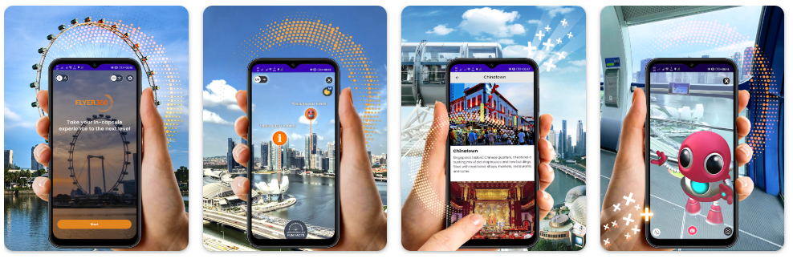
Flyer360 Mobile App
Explore points of interest surrounding the Singapore Flyer
Capture unique photos with interactive AR elements like the Merlion, otters and more
Play exciting Singapore-themed games
Discover fun facts about the Singapore Flyer
Earn and redeem rewards

Slide 4
Flyer360 Mobile App
To get the most out of your Singapore Flyer experience, we recommend downloading the app before you board.
Please note that the app is designed to work only within Singapore Flyer capsules above a certain altitude.
Plus, enjoy free Wi-Fi at Singapore Flyer by logging into Singapore Flyer Free Wi-Fi.

